Slide 1
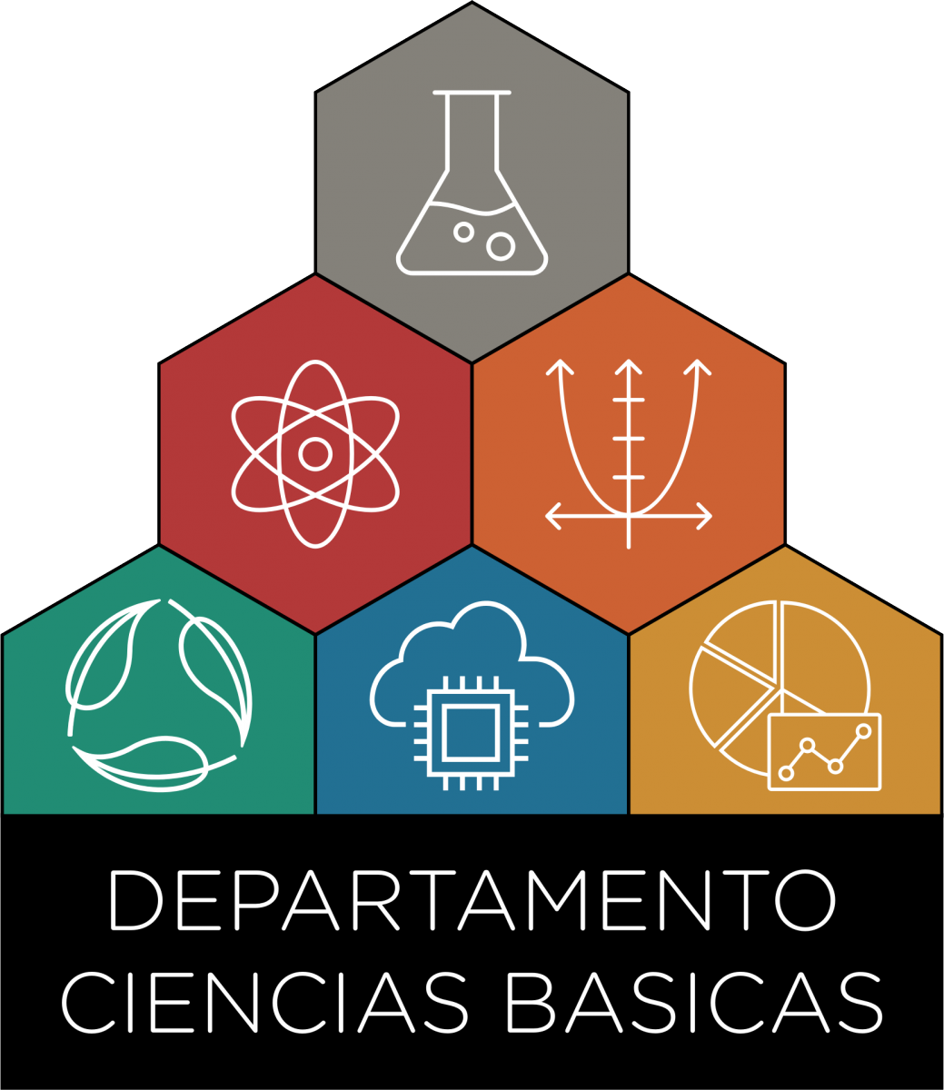

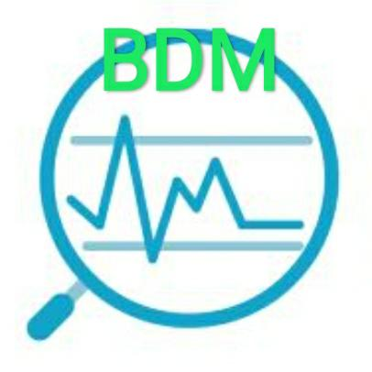
Clase 10:
Ecosistemas de Big Data
Bases de Datos Masivas (11088)
Licenciatura en Sistemas de Información
Departamento de Ciencias Básicas
Universidad Nacional de Luján

Slide 2
Big Data
Definiciones
Las … Vs
Hadoop
Ecosistemas de Big Data
HDFS
Frameworks
MapReduce
Spark

Slide 3

Big Data
Big Data estudia la forma de analizar y extraer sistemáticamente información, abordando de otra manera conjuntos de datos que son demasiado grandes o complejos para ser tratados por aplicaciones de procesamiento de datos tradicional.
Notes:
Definiciones Alternativas:
Conjuntos de datos que debido a su tamaño y complejidad no es posible procesarlo con las tecnologías y metodologías convencionales [FAN2013]
Un paradigma para permitir la recolección, almacenamiento, gestión, análisis y visualización, potencialmente bajo restricciones de tiempo real, de vastos conjuntos de datos con características heterogéneas. [ITU-T Y.3600]

Slide 4
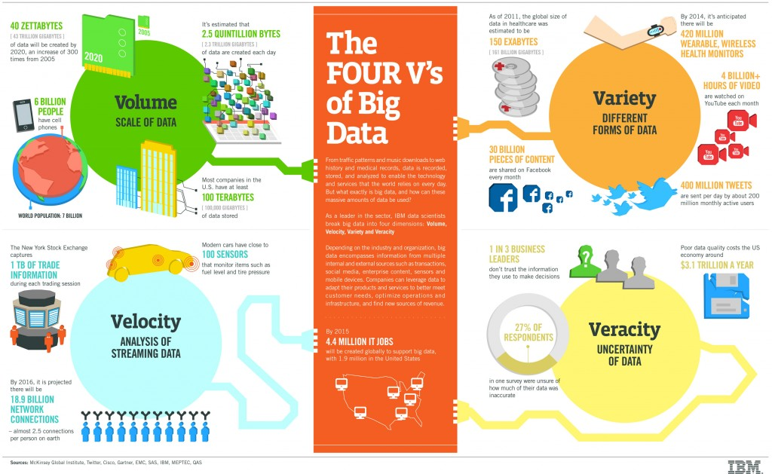

Slide 5
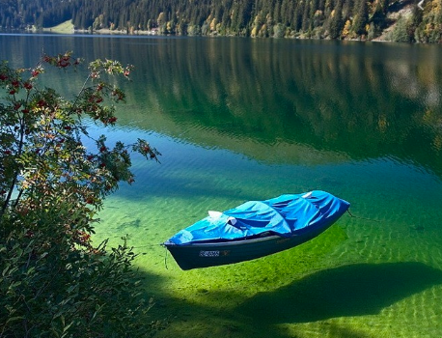

Contexto
Data Warehouse
vs
Data Lake
Sistemas distribuidos y cómputo paralelo
vs
MapReduce
Big Data
RDBM
características ACID
NoSQL
características
BASE
vs
Notes:
In the era of big data, a new term called “Data Lake” came into view of the digital universe.
The simplest intention of data lake is to munge every data produced by an organization to
give more valuable insight in finer granularity. Big Data technologies are sometimes
considered as destructive technologies as they revolutionized the traditional ways of doing
things in this data intensive era. Concepts from distributed and parallel system are reapplied
as the foundation of big data such as MapReduce paradigms for handling the big Vs
characteristics – volume, velocity, variety, value and value. The incumbent SQL databases
with ACID characteristics are challenged (and sometimes even replaced) by NoSQL
databases with BASE characteristics. Now, Data Lake concept is trying to challenge the
reliable, traditional data warehouses for storing heterogeneous complex data.
The idea of Data Lake was first initiated by Pentaho CEO Jame Dixon [9]. If a data
warehouse or data mart is seem as a bottle of water cleaned and ready for consumption,
then “Data Lake” is whole lake of data which is cleaned for ready use. Ref [16] added more
in-depth definition for Data Lake as “a Data Lake stores disparate information while
ignoring almost everything”.

Slide 6

¿Qué es Hadoop?
FS Distribuido
Framework
Data sets
Muy grandes
Notes:
Hadoop provides a distributed file system and a framework for the analysis and transformation of very large data sets using the MapReduce paradigm.
Un sistema distribuido que propone una metodología de desarrollo y procesamiento que facilita la escalabilidad de aplicaciones.
Provee un Filesystem para el almacenamiento de datos y un modelo de programación para el procesamiento de los mismos.

Slide 7
HADOOP: Características
Cluster dedicado
Commodity Hardware (Miles de nodos)
Las fallas de HW son regla, no excepción
Aplicaciones trivialmente paralelizables
Procesamiento Batch, no online (en principio)
Procesamiento en escala de Tera o Petabytes
Mover datos es caro
Mover cómputo es barato
SCHEMA-ON-READ (HADOOP):
Los datos son copiados al FS, sin cambios
Una serialización tiene lugar al momento de la lectura

Slide 8
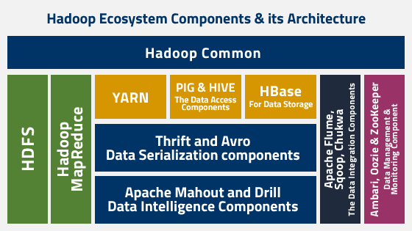
Ecosistemas de Big Data / Arquitectura Hadoop
Notes:
HDFS
HDFS is used to split files into multiple blocks.
HDFS stores the application data and the file system metadata on two different servers. NameNode is used to store the file system metadata while and application data is stored by the DataNode. To ensure the data reliability and availability to the highest point, HDFS replicates the file content many times. NameNode and DataNode communicate with each other by using TCP protocols.
Hadoop architecture performance depends upon Hard-drives throughput and the network speed for the data transfer.
MapReduce
MapReduce is a framework used for processing large datasets in a distributed environment.
The MapReduce job is based on three operations: map an input data set in different pairs, shuffle the resulting data, and then reduce overall pairs with the same key.
The job is the top level unit of MapReduce working and each job contains one or more Map or Reduce tasks.
YARN
La idea fundamental de YARN es dividir las funcionalidades de la gestión de recursos y la coordinación/monitoreo de trabajos en demonios separados
La idea es tener un ResourceManager (RM) global y un ApplicationMaster (AM) por aplicación. Una aplicación es un trabajo único o un DAG de trabajos.

Slide 9
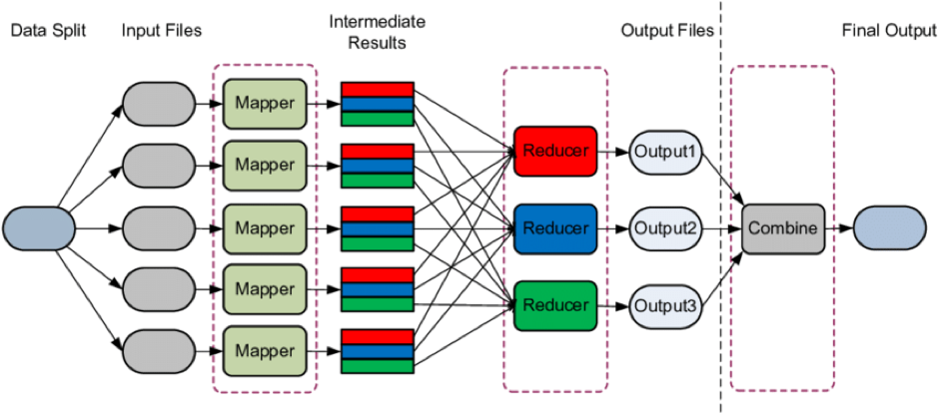
MapReduce
Hadoop MapReduce es un framework de programación para escribir aplicaciones que procesan grandes cantidades de datos, en paralelo en grandes clusters (miles de nodos) de commodity hardware de manera fiable y tolerante a las fallas.
Notes:
A MapReduce job usually splits the input data-set into independent chunks which are processed by the map tasks in a completely parallel manner. The framework sorts the outputs of the maps, which are then input to the reduce tasks.
Typically both the input and the output of the job are stored in a file-system.
The framework takes care of scheduling tasks, monitoring them and re-executes the failed tasks.

Slide 10
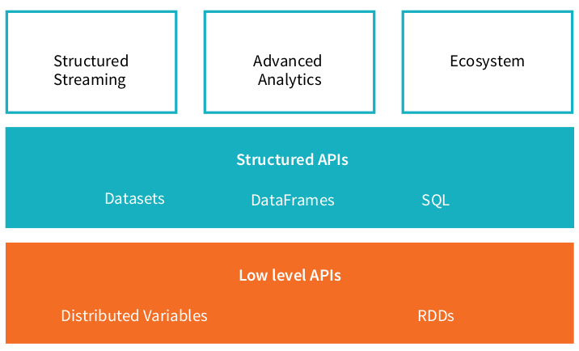
Apache Spark
Apache Spark – a unified computing engine and set of libraries for big data
Notes:
Unified: Spark is designed to support a wide range of data analytics tasks, ranging from simple data loading and SQL queries to machine learning and streaming computation, over the same computing engine and with a consistent set of APIs.
Computing Engine: At the same time that Spark strives for unification, Spark carefully limits its scope to a computing engine. Spark only handles loading data from storage systems and performing computation on it, not permanent storage as the end itself. The key motivation here is that most data already resides in a mix of storage systems. Data is expensive to move so Spark focuses on performing computations over the data, no matter where it resides.

Slide 11
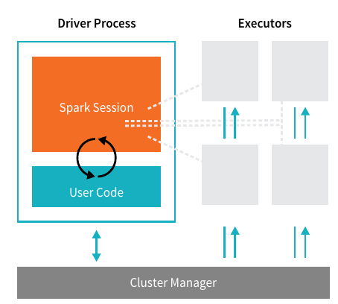
Spark: Arquitectura Básica
Aplicación Spark
Notes:
Spark Applications consist of a driver process and a set of executor processes.
The driver process runs your main() function, sits on a node in the cluster, and is responsible for three things:
maintaining information about the Spark Application;
responding to a user’s program or input; and
analyzing, distributing, and scheduling work across the executors.
The executors are responsible for actually executing the work that the driver assigns them. This means, each executor is responsible for only two things:
executing code assigned to it by the driver and
reporting the state of the computation, on that executor, back to the driver node.
The cluster manager controls physical machines and allocates resources to Spark Applications.
This can be one of several core cluster managers:
Spark’s standalone cluster manager,
YARN,
or Mesos.
This means that there can be multiple Spark Applications running on a cluster at the same time.

Slide 12
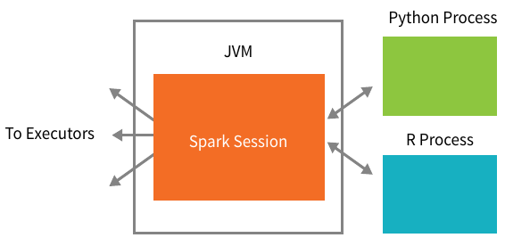
Spark API
Spark Application: Diver Process = SparkSession
Notes:
Spark’s language APIs allow you to run Spark code from other languages.
Each language API will maintain the same core concepts.
There is a SparkSession available to the user, the SparkSession will be the entrance point to running Spark code. When using Spark from a Python or R, the user never writes explicit JVM instructions, but instead writes Python and R code that Spark will translate into code that Spark can then run on the executor JVMs.
The SparkSession instance is the way Spark executes user-defined manipulations across the cluster. There is a one to one correspondence between a SparkSession and a Spark Application.

Slide 13
Referencias
https://java2blog.com/hadoop-architecture/
https://slides.com/tomasdelvechio/hadoop--2
https://spark.apache.org/docs/latest/
https://hadoop.apache.org/docs/current/hadoop-yarn/hadoop-yarn-site/YARN.html
A Gentle Introduction to Apache Spark [ site ]

